Slide 1
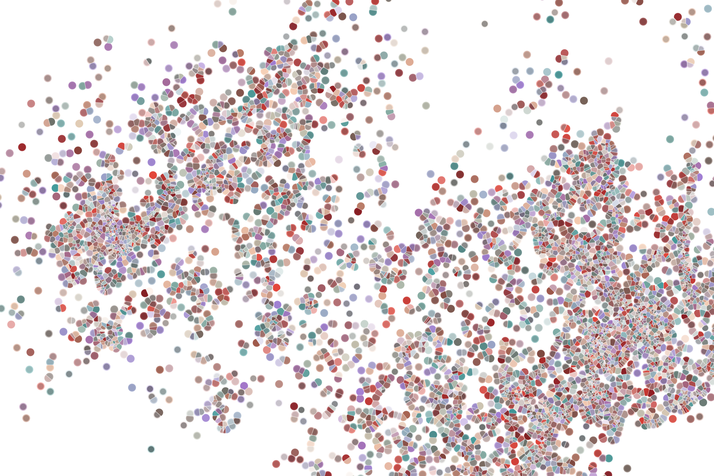
Lecture 6 Annotating cell populations
Physalia course 2021 — Single-cell RNA-seq with R/Bioconductor
Instructors: Jacques Serizay
Notes:
Hello everybody and thank you for attending my presentation. I am going to talk about the project I recently started working on in the Spassky and Koszul labs, both located in Paris. This project focuses on the unusual cooption of the mitotic machinery to drive, not cell division but cell differentiation.

Slide 2

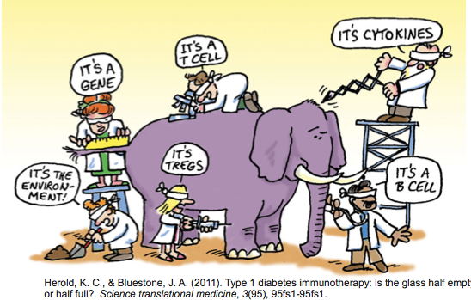
How Do We Define Cellular Identity?
A cell participates in multiple processes/contexts.
2
Notes:
I would like to expand these observations to in vivo data. I also want to check what happens in terms of transcriptional dynamics in cells where Cyclin O, a key non-canonical cyclin involved in MCC diff., is knocked-out.

Slide 3

Analysis workflow
Pre-Processing
Clustering
Biology
Expression Matrix
(GENES x CELLS)
1. Identify
Variable Genes
5. Differentially Expressed Genes
Filter Cells /
Quality Control
2. Dimensionality Reduction
6. Assigning
Cell Type
Normalization
3. Clustering
7. Functional Annotation
4. Explore (known)
marker genes
Notes:
I would like to expand these observations to in vivo data. I also want to check what happens in terms of transcriptional dynamics in cells where Cyclin O, a key non-canonical cyclin involved in MCC diff., is knocked-out.

Slide 4
Analysis workflow
Pre-Processing
Clustering
Biology
Expression Matrix
(GENES x CELLS)
1. Identify
Variable Genes
5. Differentially Expressed Genes
Filter Cells /
Quality Control
2. Dimensionality Reduction
6. Assigning
Cell Type
Normalization
3. Clustering
7. Functional Annotation
4. Explore (known)
marker genes
Notes:
I would like to expand these observations to in vivo data. I also want to check what happens in terms of transcriptional dynamics in cells where Cyclin O, a key non-canonical cyclin involved in MCC diff., is knocked-out.

Slide 5
Analysis workflow
Pre-Processing
Clustering
Biology
Expression Matrix
(GENES x CELLS)
1. Identify
Variable Genes
5. Differentially Expressed Genes
Filter Cells /
Quality Control
2. Dimensionality Reduction
6. Assigning
Cell Type
Normalization
3. Clustering
7. Functional Annotation
4. Explore (known)
marker genes
Notes:
I would like to expand these observations to in vivo data. I also want to check what happens in terms of transcriptional dynamics in cells where Cyclin O, a key non-canonical cyclin involved in MCC diff., is knocked-out.

Slide 6
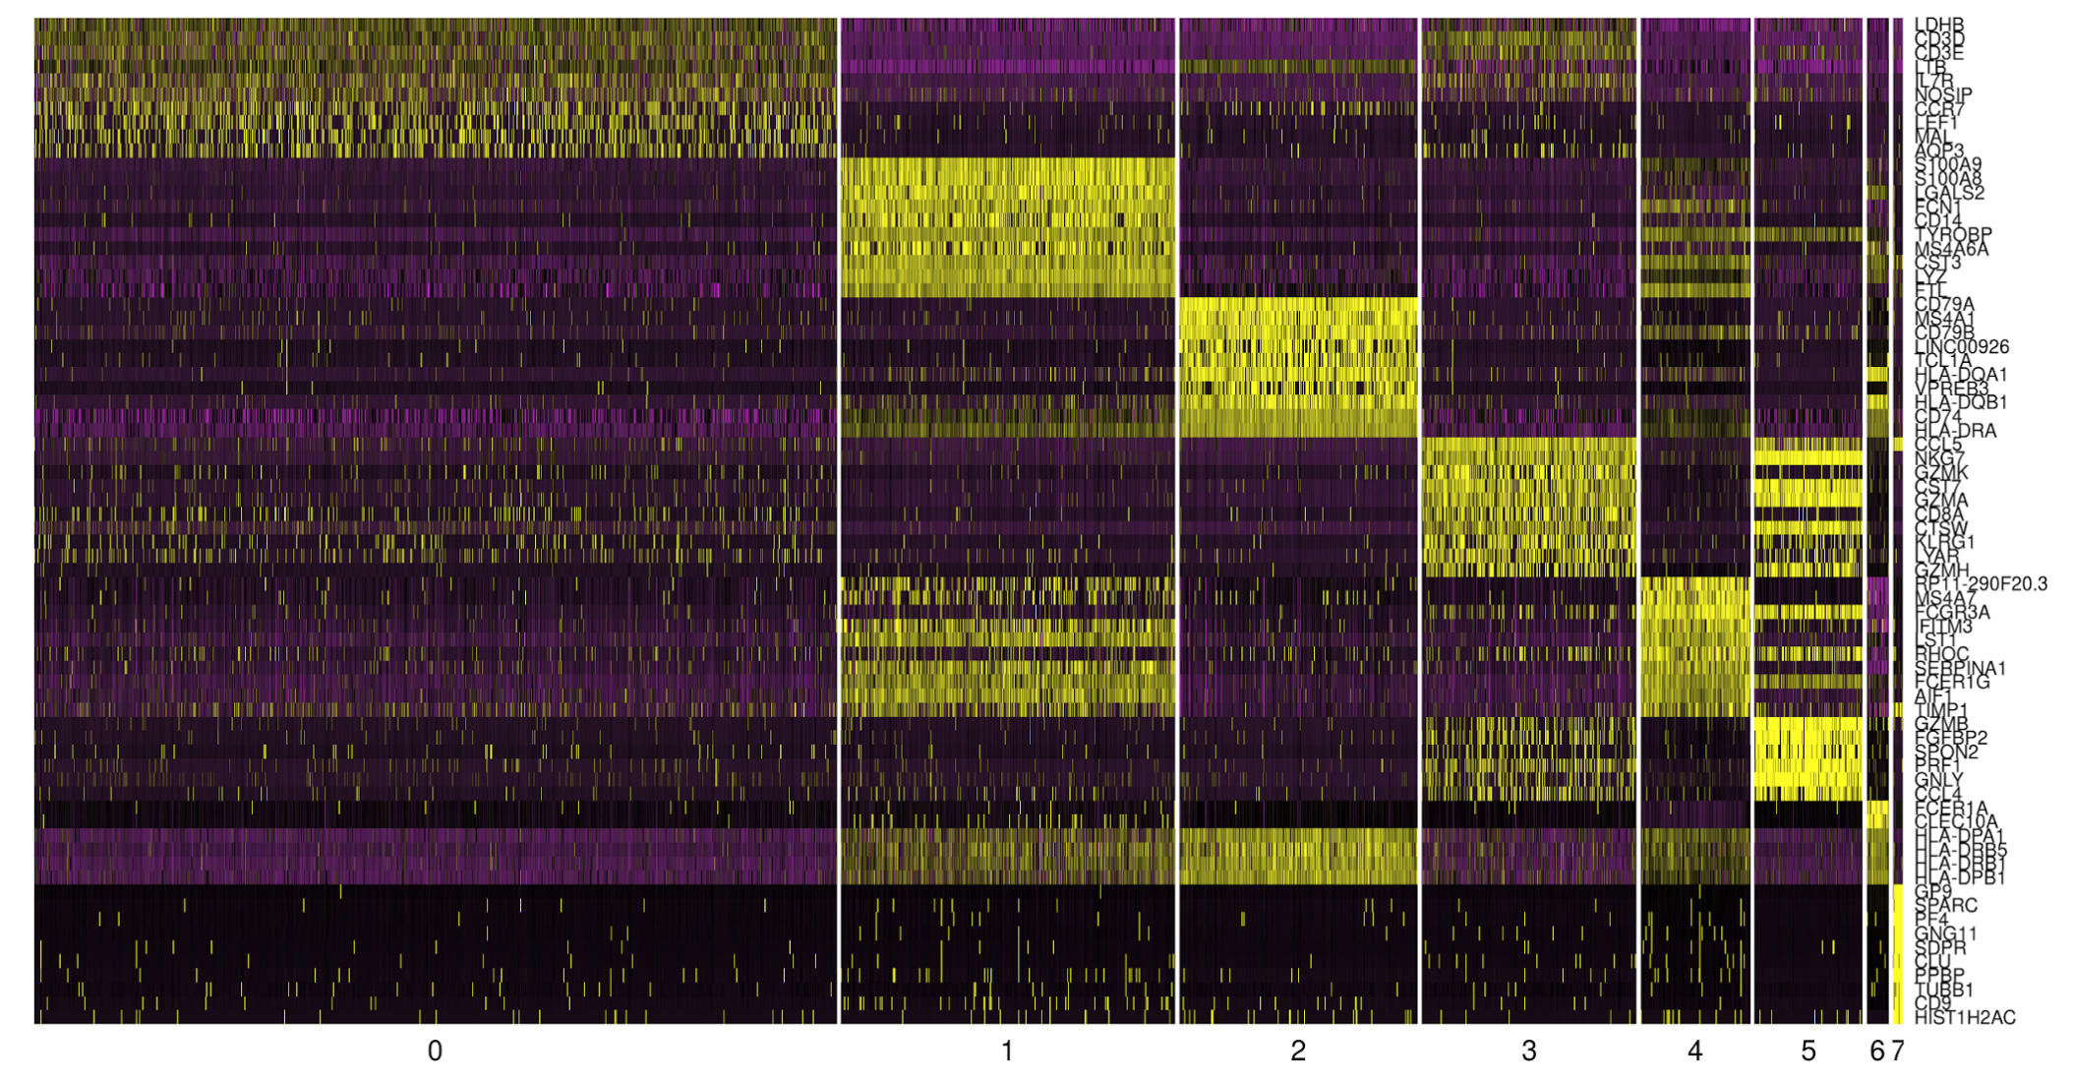
Cell type annotation using identified markers per cluster
Genes
Cell clusters
6
Notes:
I would like to expand these observations to in vivo data. I also want to check what happens in terms of transcriptional dynamics in cells where Cyclin O, a key non-canonical cyclin involved in MCC diff., is knocked-out.

Slide 7
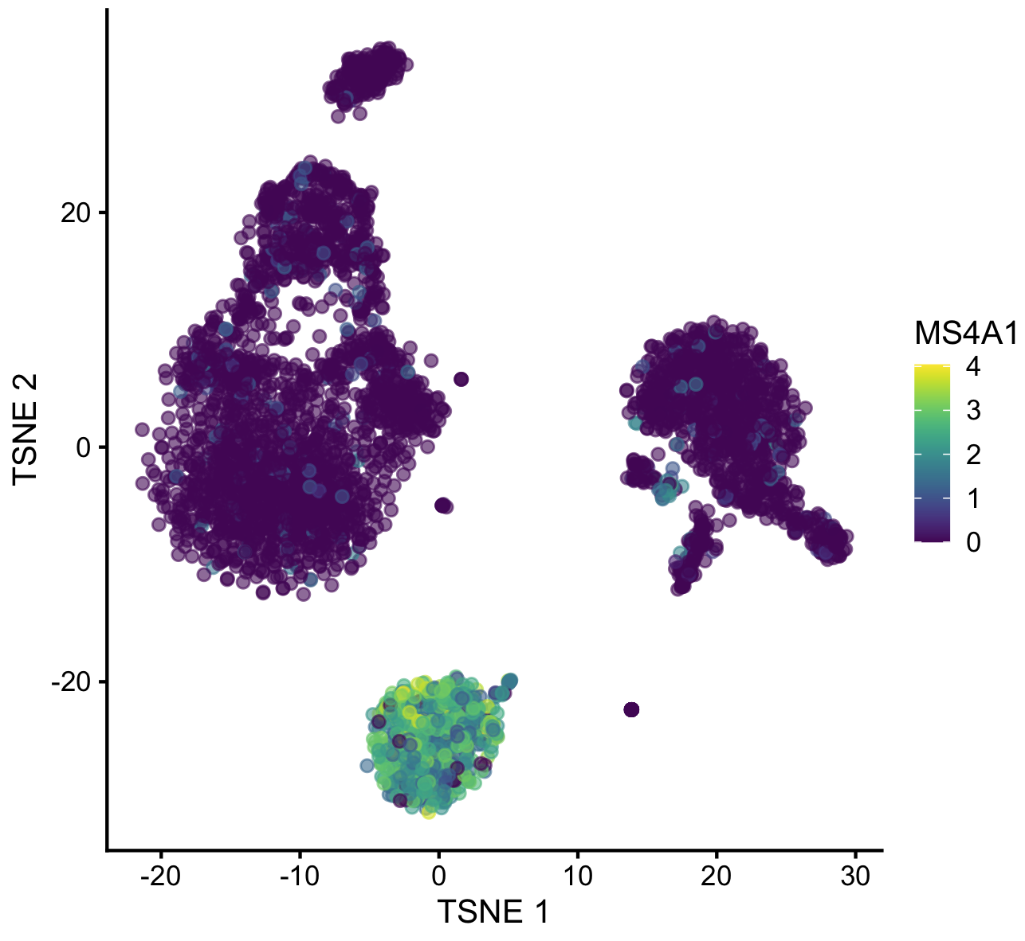
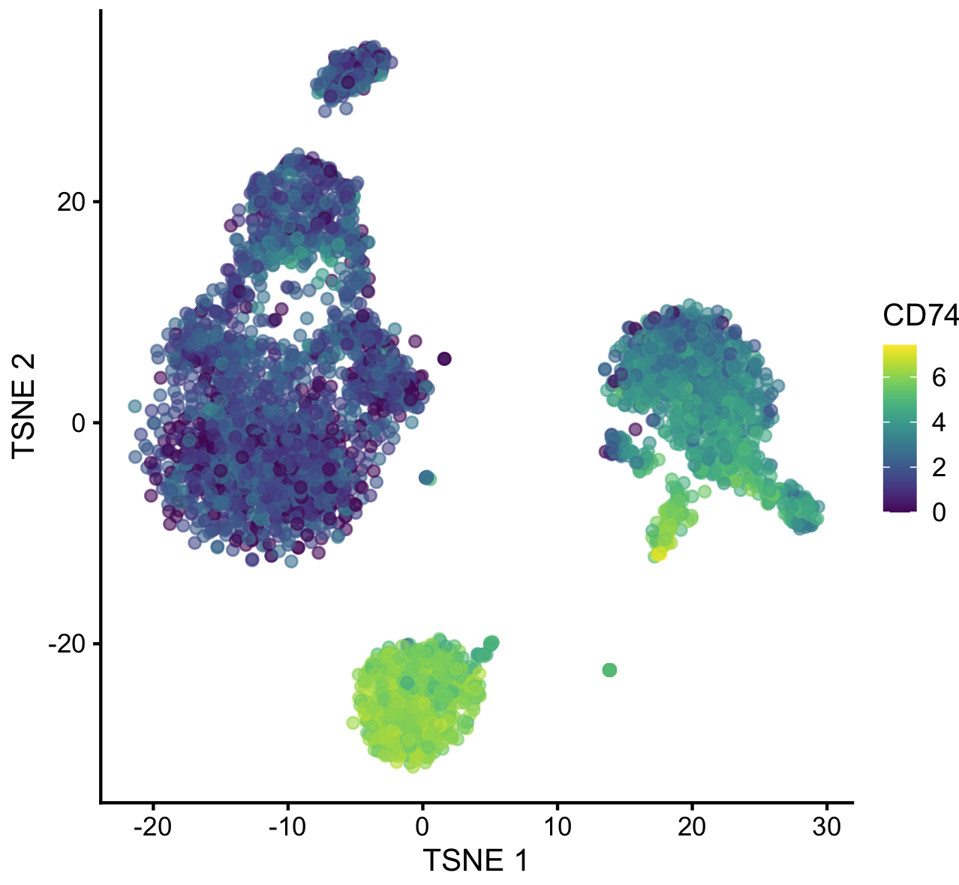
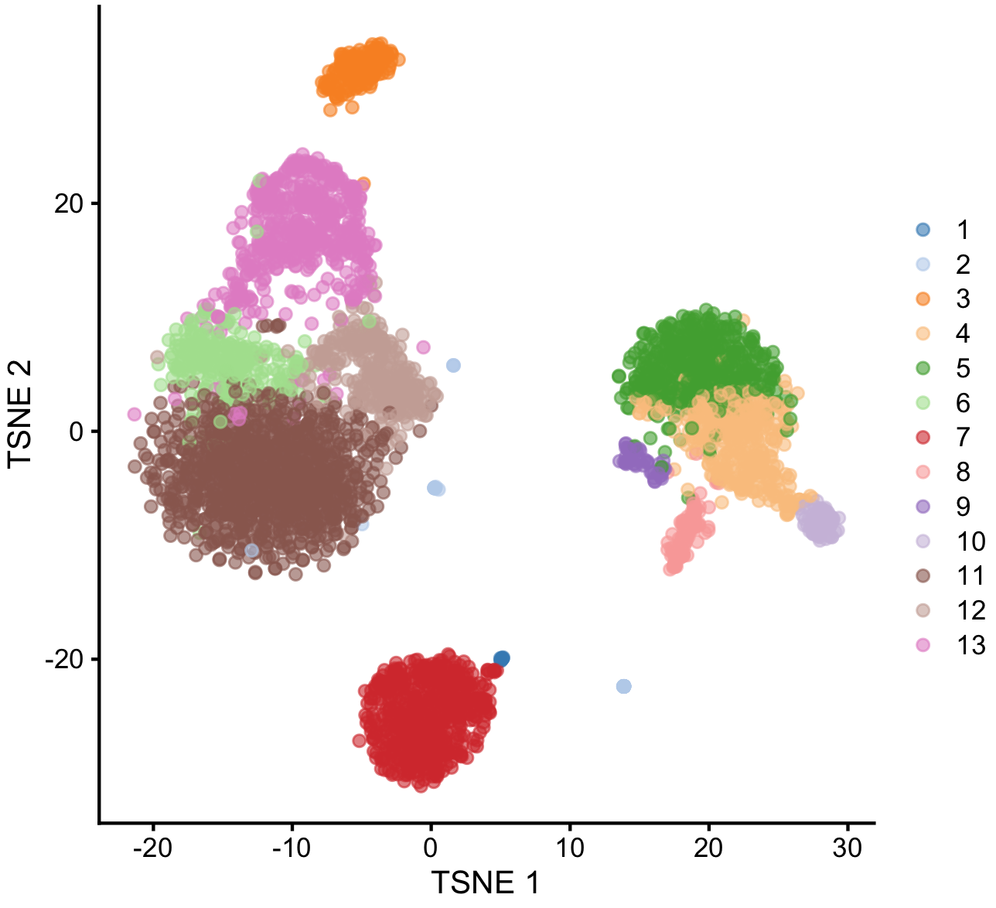
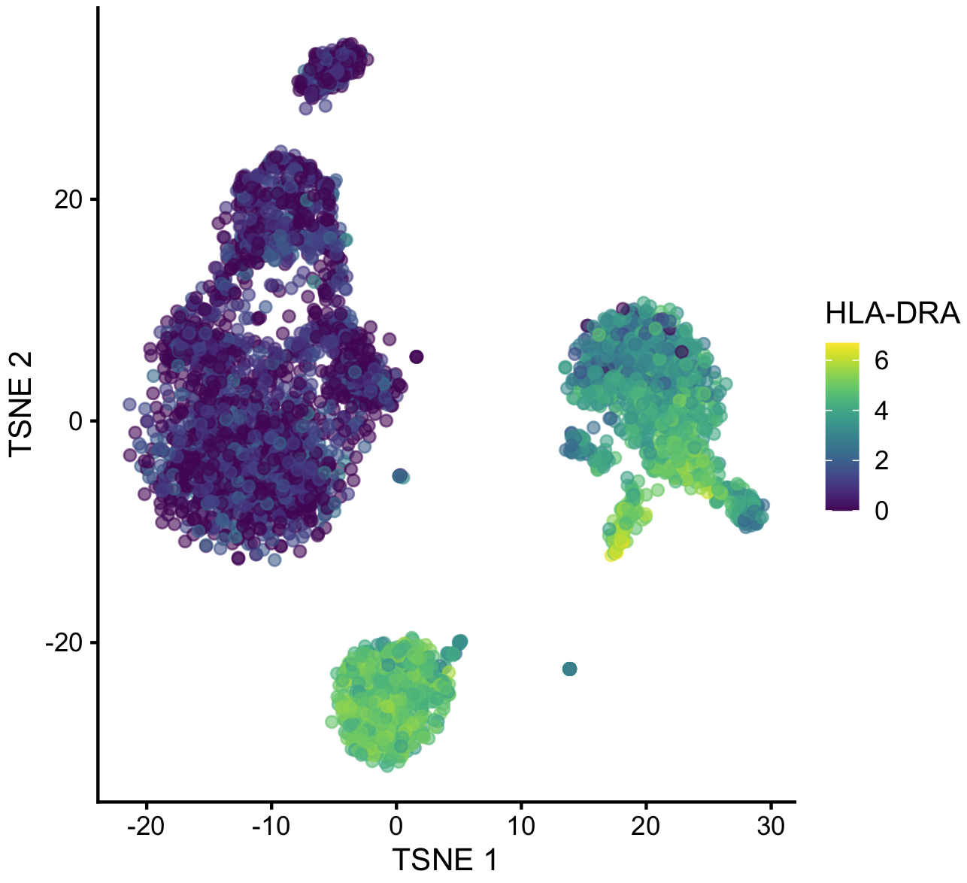

Manual cell type annotation using identified markers per cluster
Top markers of cluster #7 in PBMCs:
CD74
HLA-DRA
MS4A1
CD79A
HLA-DRB1
HLA-DPA1
CD79B
LTB
HLA-DQB1
TCL1A
CD52
HLA-DPB1
CD37
7
Notes:
I would like to expand these observations to in vivo data. I also want to check what happens in terms of transcriptional dynamics in cells where Cyclin O, a key non-canonical cyclin involved in MCC diff., is knocked-out.

Slide 8
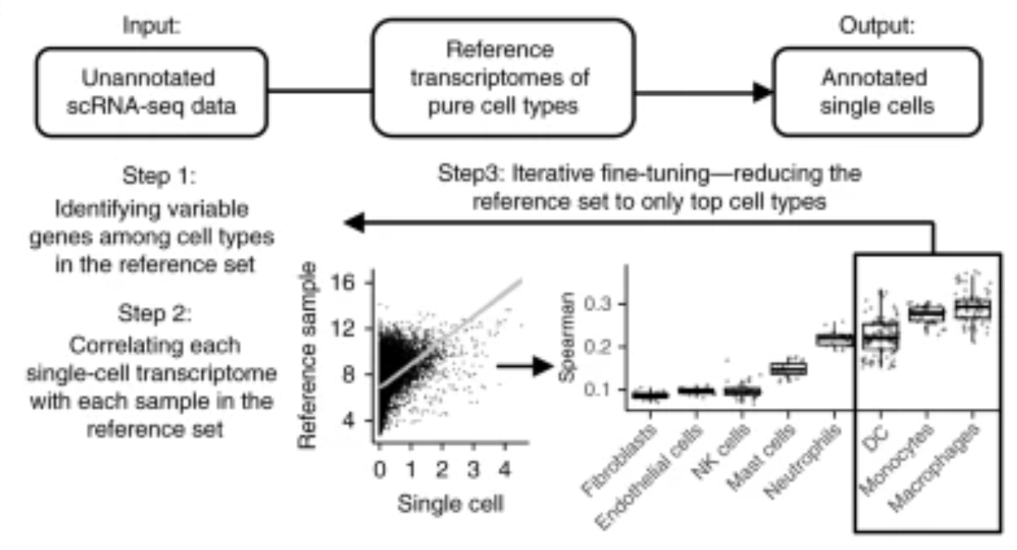
Automated cell type annotation using public marker databases
SingleR can rely on references of pure cell types to annotate individual cells within a scRNAseq dataset.
Aran et al., Nat. Immuno. 2019
8
Notes:
I would like to expand these observations to in vivo data. I also want to check what happens in terms of transcriptional dynamics in cells where Cyclin O, a key non-canonical cyclin involved in MCC diff., is knocked-out.

Slide 9
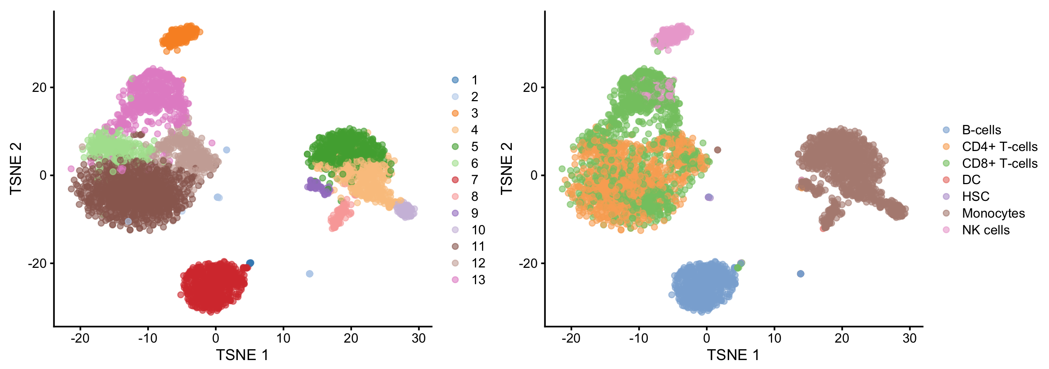
Automated cell type annotation using public marker databases
SingleR can rely on references of pure cell types to annotate individual cells within a scRNAseq dataset.
However, it is limited in sensitivity, as it can only identify cells based on the references used.
9
Notes:
I would like to expand these observations to in vivo data. I also want to check what happens in terms of transcriptional dynamics in cells where Cyclin O, a key non-canonical cyclin involved in MCC diff., is knocked-out.

Slide 10
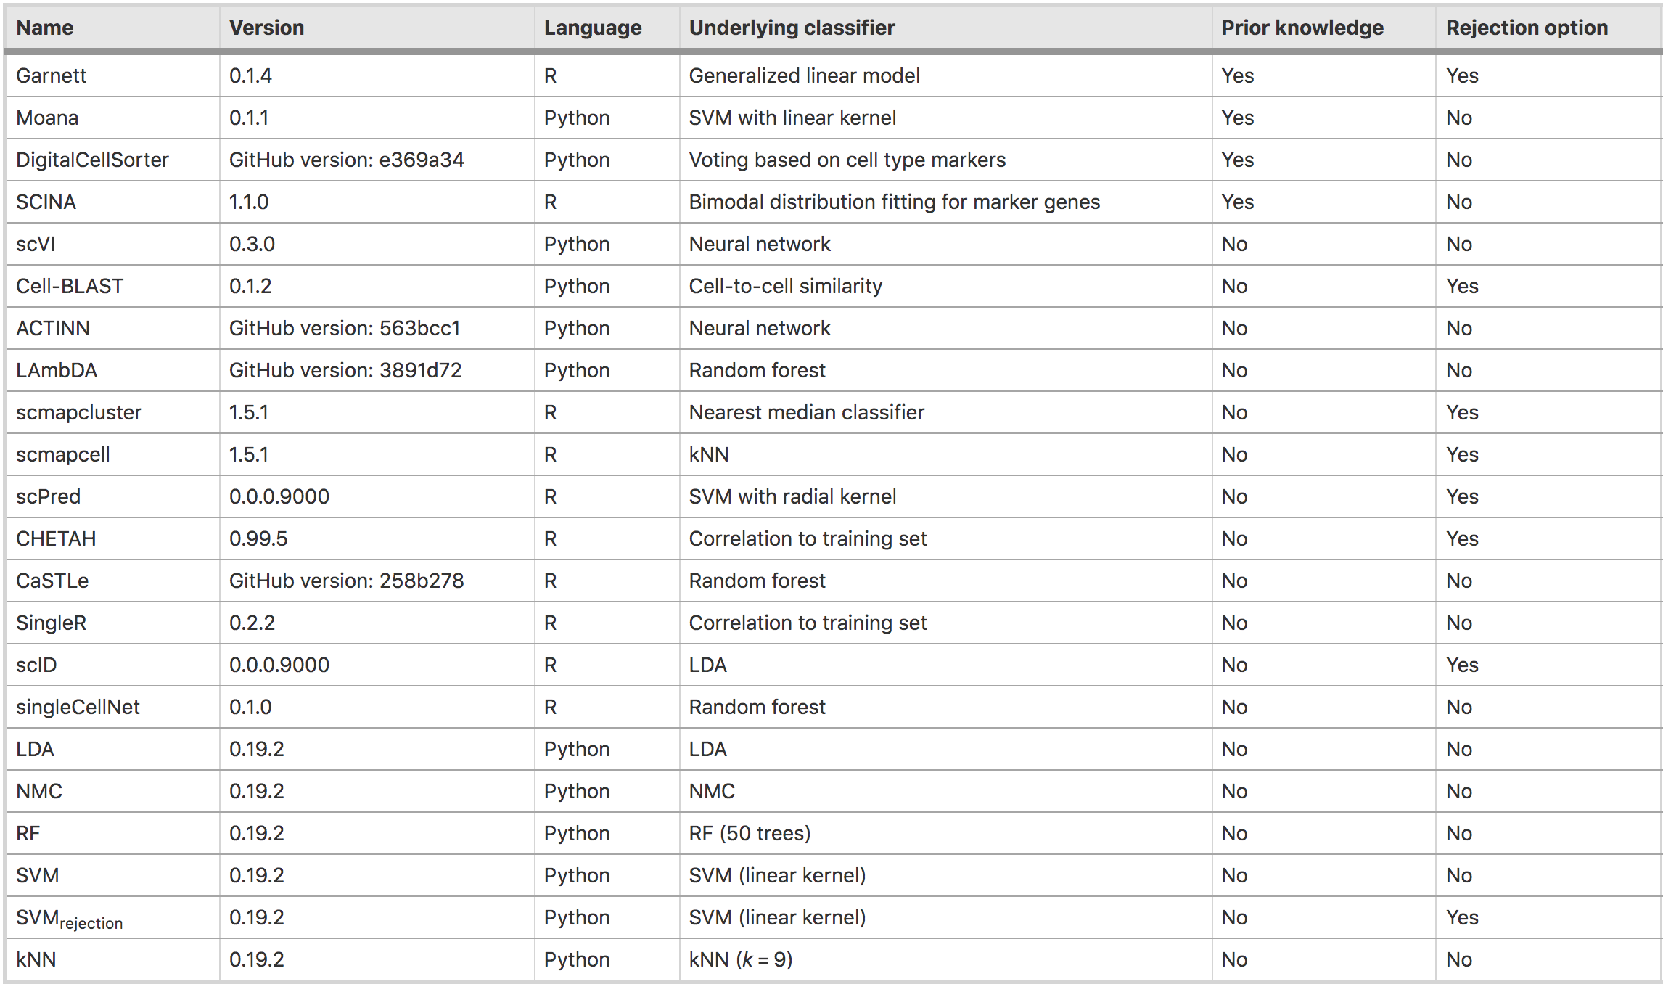
Automated cell type annotation using public marker databases
Huge (and growing!) collection of tools for automated cell annotation…
Abdelaal et al., Genome Biol. 2019
10
Notes:
I would like to expand these observations to in vivo data. I also want to check what happens in terms of transcriptional dynamics in cells where Cyclin O, a key non-canonical cyclin involved in MCC diff., is knocked-out.

Slide 11
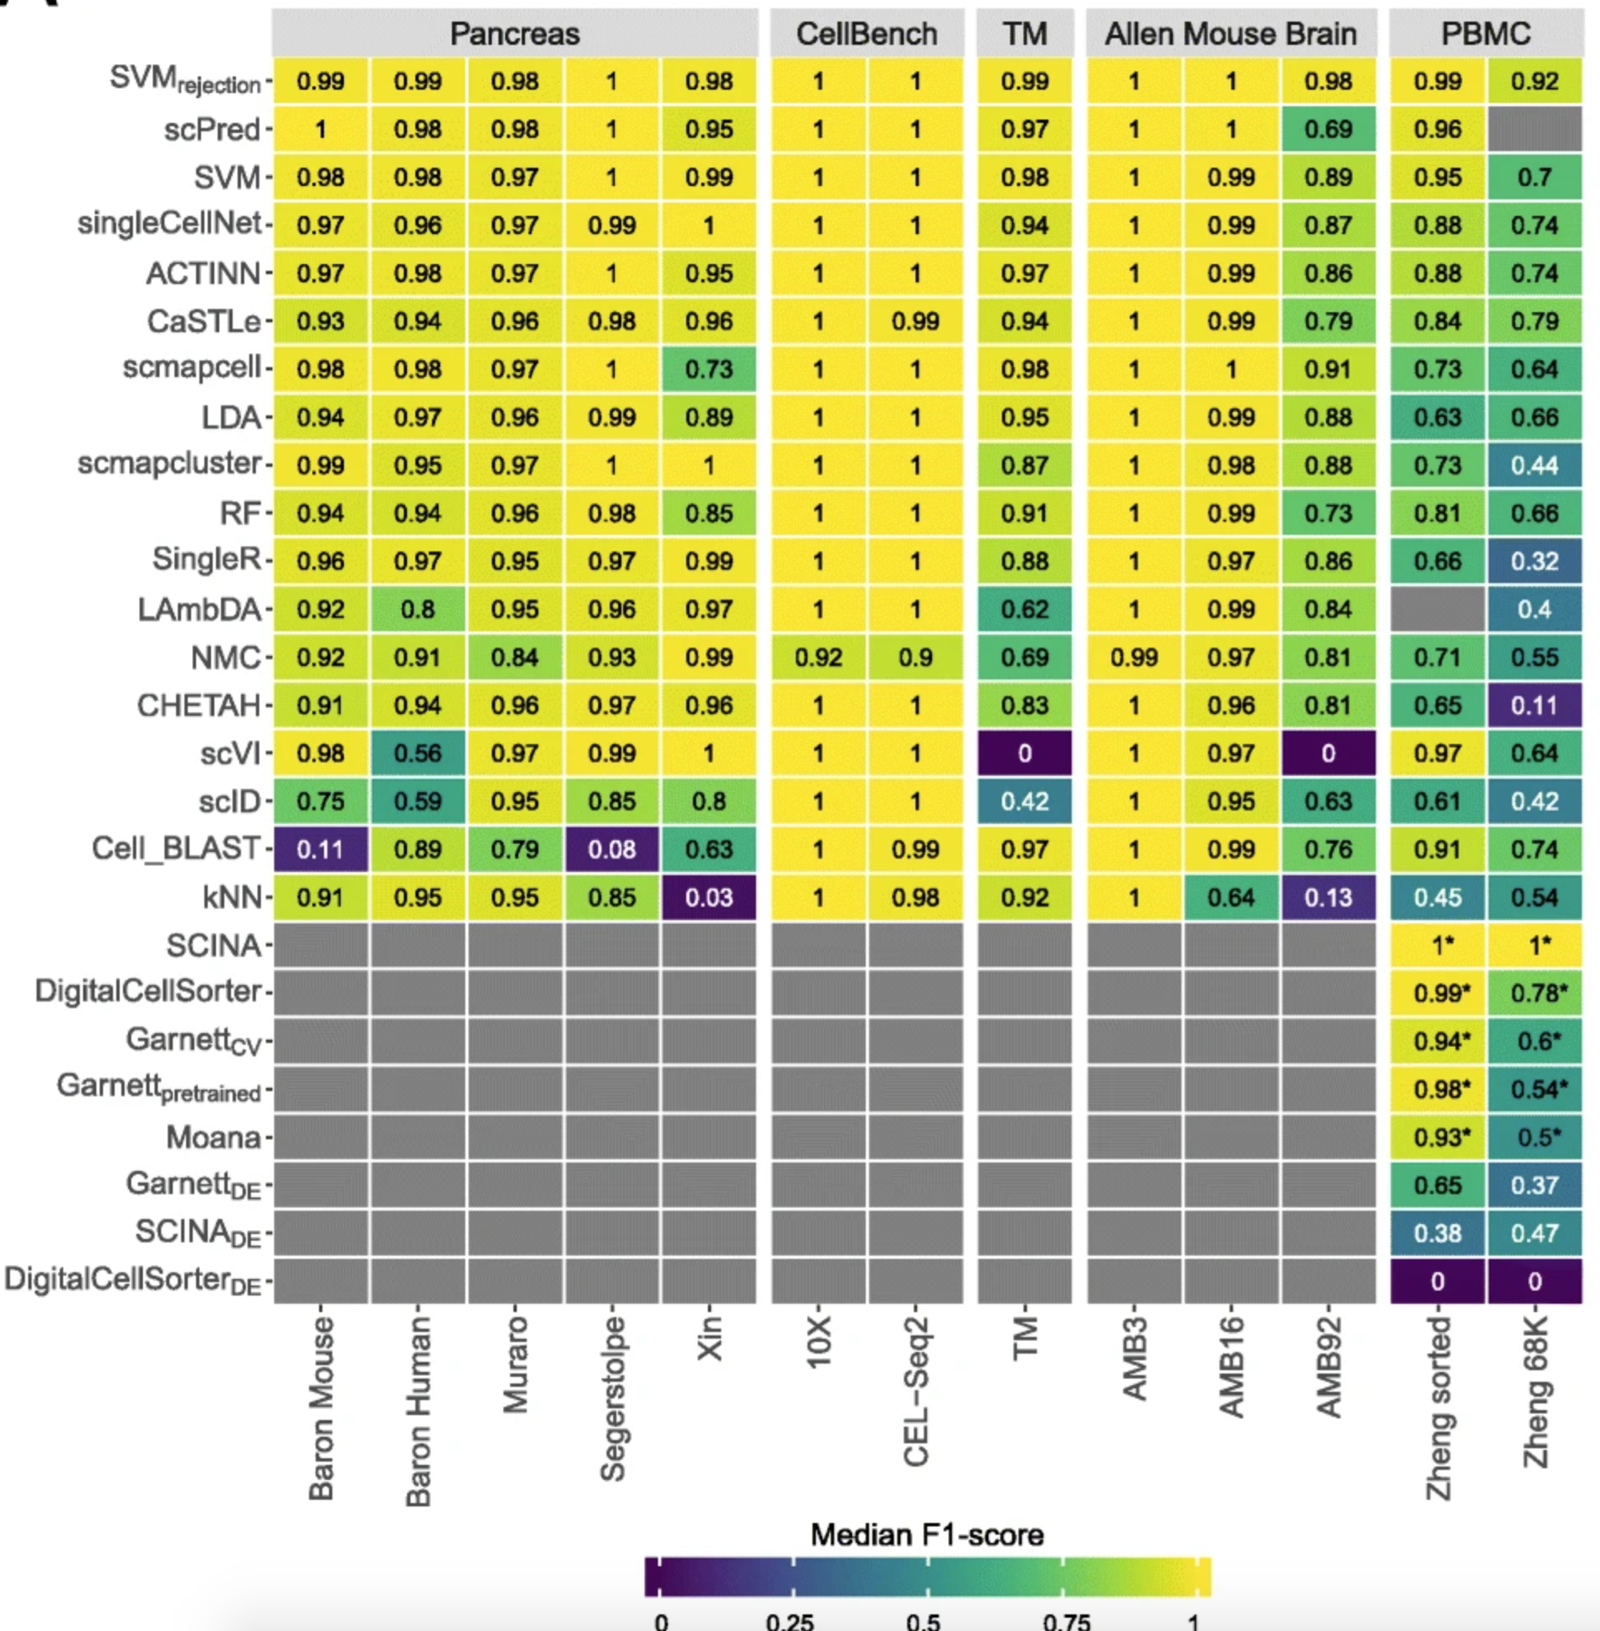
Automated cell type annotation using public marker databases
Huge (and growing!) collection of tools for automated cell annotation…
Abdelaal et al., Genome Biol. 2019
11
Notes:
I would like to expand these observations to in vivo data. I also want to check what happens in terms of transcriptional dynamics in cells where Cyclin O, a key non-canonical cyclin involved in MCC diff., is knocked-out.

Slide 12
Analysis workflow
Pre-Processing
Clustering
Biology
Expression Matrix
(GENES x CELLS)
1. Identify
Variable Genes
5. Differentially Expressed Genes
Filter Cells /
Quality Control
2. Dimensionality Reduction
6. Assigning
Cell Type
Normalization
3. Clustering
7. Functional Annotation
4. Explore (known)
marker genes
Notes:
I would like to expand these observations to in vivo data. I also want to check what happens in terms of transcriptional dynamics in cells where Cyclin O, a key non-canonical cyclin involved in MCC diff., is knocked-out.

